Slide 1




AICTE
AI
MENTAL FITNESS
TRACKER

Slide 2


CONTENT
01
02
03
04
05
About
Problem Statement
Agenda
Overview
Target Audience
06
07
08
09
10
Solution
Customization
Modelling
Results
Links

Slide 3

ABOUT
Name: Rahul
SkillsBuild Email ID: rahulkumar.me.21@nitap.ac.in
College Name: National Institute of Technology
College State: Arunachal Pradesh
Internship Domain: Artificial Intelligence
Internship Start & End Date: 12 June, 2023 - 24 July, 2023

Slide 4

PROBLEM STATEMENT
To develop a Python-based predictive model using AI technology that functions as a mental fitness tracker, providing real-time insights and personalized recommendations to enhance individuals' mental well-being and track their progress over time

Slide 5



AGENDA
Introduction
Problem Statement/Project Topic
Methodology and Data Collection
Model Development and Training
Predictive Model Results and Interpretation
Implementation and User Interface
Potential Applications and Future Enhancements
Q&A and Discussion
Conclusion and Closing Remarks

Slide 6

OVERVIEW
Purpose
Scope
Objectives
Develop a predictive model
Revolutionize mental health monitoring and management.
Provide accurate predictions and personalized interventions.
Develop a robust predictive model using machine learning techniques.
Analyze various data inputs related to mental health
Implement a user-friendly interface for seamless interaction.
Develop an advanced predictive model.
Provide personalized recommendations.
Design an intuitive user interface.
Evaluate and refine the model continuously.

Slide 7




TARGET AUDIENCE
CHARACTERSTICS
NEEDS
BENEFITS

Slide 8

CHARACTERSTICS
Individuals seeking to monitor and improve their mental well-being.
People interested in proactive mental health management.
Users comfortable with technology and data-driven approaches.
Professionals in the mental health field.

Slide 9

NEEDS
Accurate tracking and monitoring of mental well-being.
Personalized interventions and recommendations.
Easy-to-use and intuitive interface.
Privacy and data security.
Access to comprehensive insights and predictions.

Slide 10

BENEFITS
Precise predictions of mental well-being based on diverse data inputs.
Personalized interventions tailored to individual needs.
Improved awareness and understanding of mental health patterns.
Potential early detection and prevention of mental health issues.

Slide 11
SOLUTIONS
Comprehensive Tracking and Analysis:Advanced algorithms analyze diverse data inputs, providing a holistic view of mental well-being.
Accurate Predictions and Personalized Interventions: Precise predictions and tailored recommendations empower users to proactively improve their mental health.
User-Friendly Interface: Intuitive interface allows easy tracking, personalized recommendations, and progress monitoring.
Privacy and Data Security: Strict adherence to privacy regulations ensures confidentiality and builds trust.
Enhanced Awareness and Early Intervention: Insights enable early detection and prevention of mental health issues.

Slide 12






INNOVATIVE SOLUTION
01
02
Advanced Algorithm
Holistic Approach
Integration of various factors like mood, sleep, activity, and social interactions allows for a comprehensive understanding of mental health
Cutting-edge algorithms to analyze diverse data inputs, providing accurate predictions
AI
03
04
05
User-Centric Design
Proactive Intervention
Collaborative Potential
With an intuitive interface, our solution prioritizes user experience, making mental health tracking and improvement accessible and engaging.
Early detection and prevention of mental health issues help users to take proactive steps towards better well-being, setting it apart from traditional reactive approaches.
Fosters collaboration between users and mental health professionals, combining data-driven insights with expert guidance for a more effective and comprehensive approach to mental health management.

Slide 13



MODELLING
Techniques, Methodologies, Frameworks used and Technology Principles utilized to develop the solution
Machine Learning
Data Analysis
Agile Development
For accurate predictions
To analyze diverse data inputs
Iterative and adaptive approach
Linear Regression
Logistic Regression
Convolutional Neural Networks (CNN)
Recurrent Neural Networks (RNN)
Exploratory Data Analysis (EDA)
Data Preprocessing
Statistical Analysis
Model Evaluation
Collaboration & flexibility
Frequent feedback loops
Scrum or Kanban
Regular Stakeholder Engagement

Slide 14


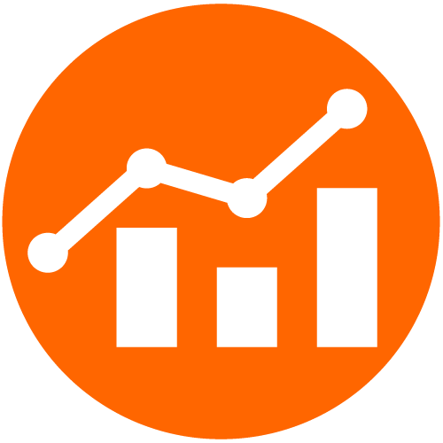



RESULTS
Quantitative Data
Evidence of Effectiveness
Demonstrating improved mental well-being metrics through data-driven analysis and comparison before and after using the solution.
Showcasing research studies or case studies validating the solution's impact on mental well-being and user satisfaction.
Qualitative Feedback
User Adoption
Gathering positive user testimonials and feedback on the solution's effectiveness in improving mental health.
Showcasing a high adoption rate and user retention, indicating the solution's value and relevance in supporting mental fitness.

Slide 15





LINKS
LinkedIn
LinkedIn Profile
LinkedIn Post
Google Drive
Google Drive Folder
GitHub
GitHub Repository

Slide 16




THANKS FOR WATCHING

